Slide 1


ML Bootcamp For Freshers
Organised by DSC NIT Patna & HackSlash Club

Slide 2

Get to know more about myself
My Name is Sai Durga Kamesh Kota. I am currently doing my internship as a Explorer Fellow at MLH Powered by Github. I am a ML Enthusiast and a cloud developer. I like to work on DL Models and currently the Machine Learning Departmental Lead and DSC NITP. I Love to explore new technologies in computer science like Blockchain. I am an Open source Contributor as well. You can reach out to me as well for any help. I am ready to help you out.
You can connect me at
Linkedin :- https://www.linkedin.com/in/saidurgakameshkota/
You can follow me on medium for Latest AI/ML Articles
Medium:- https://saidurgakameshkota.medium.com/
MLH Fellow 21, DSC ML Lead, 3rd Year Undergrad in CSE NIT Patna

Slide 3
Agenda For Today’s Session
Discuss about what actually Supervised Learning is
Discuss about Logistic Regression
Do Hands on Logistic Regression
Discuss about KNN
Do Hands on KNN
Discuss about Decision Trees
Do Hands on Decision Trees
Q & A

Slide 4
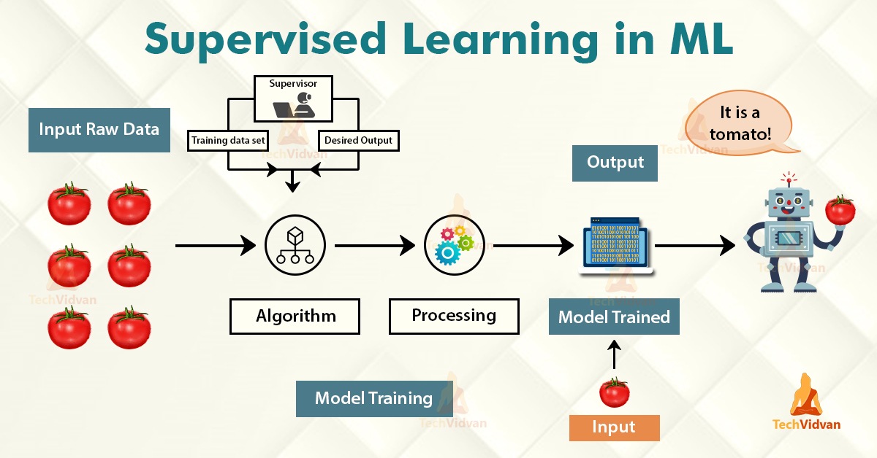
Supervised Learning
Supervised Learning is the process of making an algorithm to learn to map an input to a particular output.
This is achieved using the labelled datasets that you have collected.
If the mapping is correct, the algorithm has successfully learned. Else, you make the necessary changes to the algorithm so that it can learn correctly.
Supervised Learning algorithms can help make predictions for new unseen data that we obtain later in the future.

Slide 5
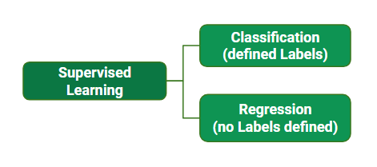
Types of Supervised Learning

Slide 6
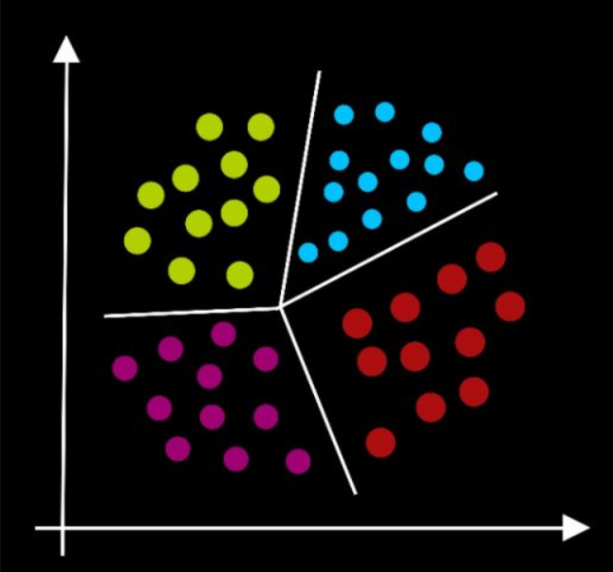
Classification Algorithm & Types
Classification predictive modeling involves assigning a class label to input examples.
Binary classification refers to predicting one of two classes and multi-class classification involves predicting one of more than two classes.
Multi-label classification involves predicting one or more classes for each example.
Some Examples of Classification Algorithms are
Logistic Regression
K Nearest Neighbours
Decision Trees
Random Forest
Naive Bayes
Support Vector Machine & Many more

Slide 7
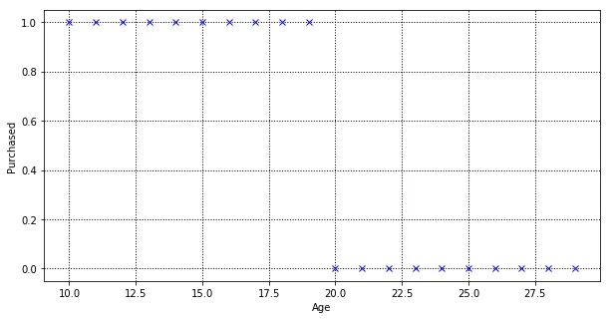
Can we use Linear Regression for Classification?
It is not recommended to use linear regression for classification tasks because of following 2 reasons. They are
Predicted Value is Continuous but not probabilistic
It is very sensitive to imbalanced data
Let’s look at a nearly balanced dataset
Scatter Plot for the dataset

Slide 8
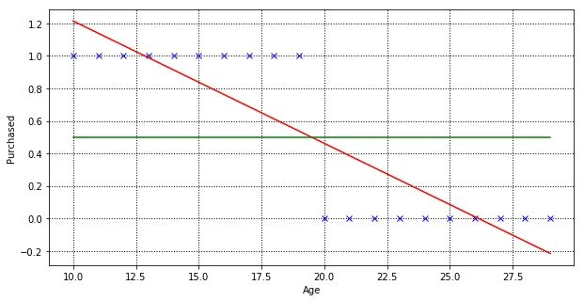
Reason 1:-
Predicted Value in Linear regression is continuous but not probabilistic ( 0 to 1 )
When data is fitted to Linear Regression

Slide 9
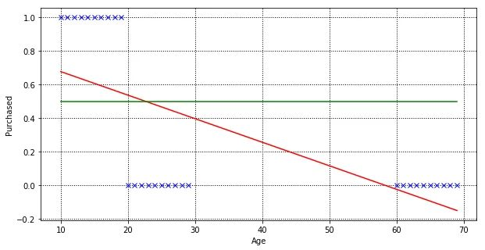
Reason 2:-
Very Sensitive towards Imbalanced Data
When imbalanced data is fitted to Linear Regression

Slide 10
Logistic Regression In Depth
You can find the in depth understanding of logistic regression from the below given link
https://drive.google.com/file/d/11yBsoLq-Zz7vroV9GWxw9GAJkEz51Kyr/view?usp=sharing

Slide 11
Now Let’s Do
Logistic Regression Hands On

Slide 12
KNN In Depth
You can find the in depth understanding of K Nearest Neighbours from the below given link
https://drive.google.com/file/d/121tM1LOgXwCgos0DvRVZKLXVPUHr7uQh/view?usp=sharing
KNN Visualiser :- https://github.com/ksdkamesh99/KNN-Visualiser

Slide 13
Now Let’s Do
KNN Hands On

Slide 14
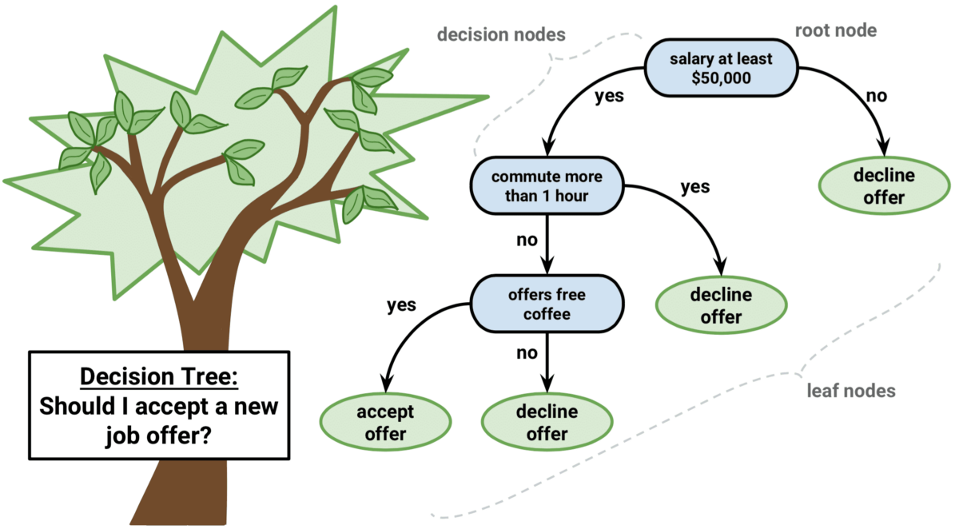
Decision Trees

Slide 15
Now Let’s Do
Decision Tree Hands On

Slide 16
You can find the Source Code here :-
https://github.com/ksdkamesh99/DSC-ML-Sessions/tree/main/ML%20Bootcamp%20on%2013-02-2021

Slide 17
Q & A
Feel Free to ask any questions on this session

Slide 18


